Slide 1

A Project Overview – “Estimating the accuracy of Moho depth estimates from gravity inversion”
By Aidan Hernaman
Supervised by Dr. Leonardo Uieda
University of Liverpool
Notes:
Hi welcome to my project talk entitled “Estimating the accuracy of Moho depth estimates from gravity inversion” and supervised by Leonardo Uieda.

Slide 2
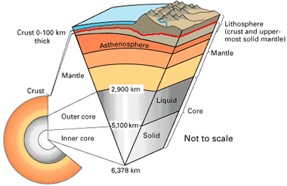
Introduction to the problem
Moho
The Mohorovičić discontinuity (Moho) is an inverse problem
Needs data to estimate boundary
Many have modelled the Moho such as Assumpção (2013), Uieda & Barbosa (2017), and Reguzzoni (2015)
Almost no models include uncertainties of these Moho estimates
Figure 1- A section of the Earth split into its different components. (Hobart M. King, Mohorovičić discontinuity, Geology.com, viewed 3 January 2021, <https://geology.com/articles/mohorovicic-discontinuity.shtml>)

Slide 3
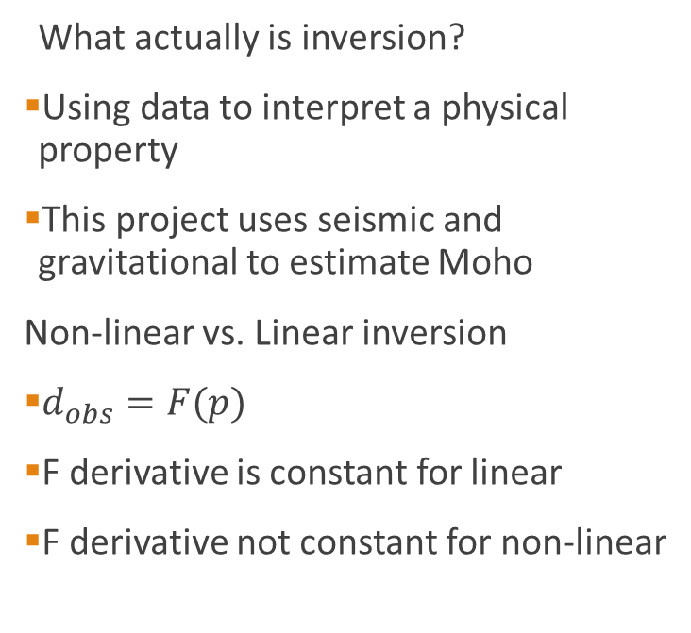
Introduction to the problem
What actually is inversion?
Using data to interpret a physical property
This project uses seismic and gravitational to estimate Moho
Non-linear vs. Linear inversion
$d_{obs}=F(p)$
F derivative is constant for linear
F derivative not constant for non-linear
Earths Physical Properties
Measurements=data
Pre-processing and Prior information
Inversion
Model

Slide 4
Background work already completed
Have been working on this project since August 2020 and since then have:
Learnt how to use the GitHub website
Background reading on the field
Studied basics of geophysical inversion (linear and non-linear)
A literature review of the current state of the field
Notes:
-project is non-linear

Slide 5
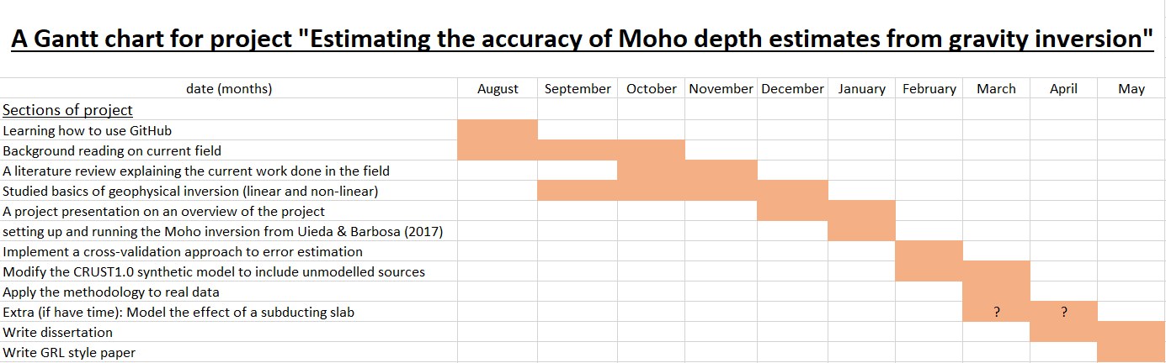
What still needs to be done - a timeline
Have created a Gantt chart to track progress to date and going forward:
Notes:
-Here I have created a Gantt chart or timeline for this project, as mentioned in the previous slide all the things I have already done are shown on this chart. And what I intend to do is too along with a timeframe of when these things will be completed. The question marks indicate a section that may or may not be competed and is time dependent. This will not take anything away from the project if not done but will be the cherry on the cake if it is and works.

Slide 6
How the rest of the project will be completed
What still needs to be completed based off the Gantt chart:
Setting up and running inversion from Uieda & Barbosa (2017)
Implement a cross validation approach to error estimation
Modify the CRUST1.0 (Laske (2013)) synthetic model to include unmodelled sources
Apply methodology to real data
Extra (time dependent): model effect of a subducting slab

Slide 7
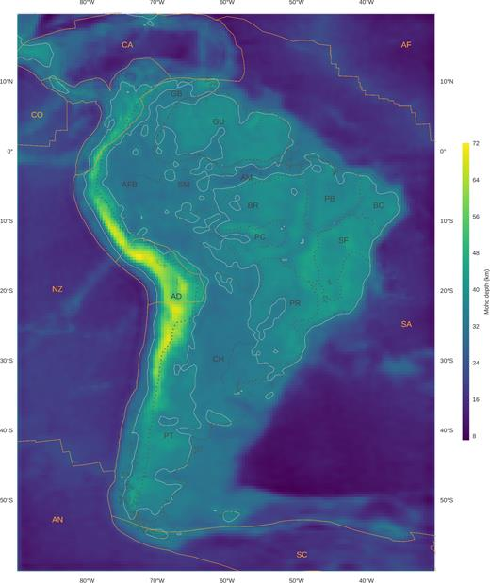
Setting up and running inversion
Setting up and running inversion from Uieda & Barbosa (2017):
Run python code create model of South American Moho
Fix any bugs or glitches
Left is original model from 2017
Figure 3- A Moho depth model of South America from Uieda & Barbosa(2017). Uieda, L. and Barbosa, V.C., 2017. Fast nonlinear gravity inversion in spherical coordinates with application to the South American Moho. Geophysical Journal International, 208(1), pp.162-176.

Slide 8
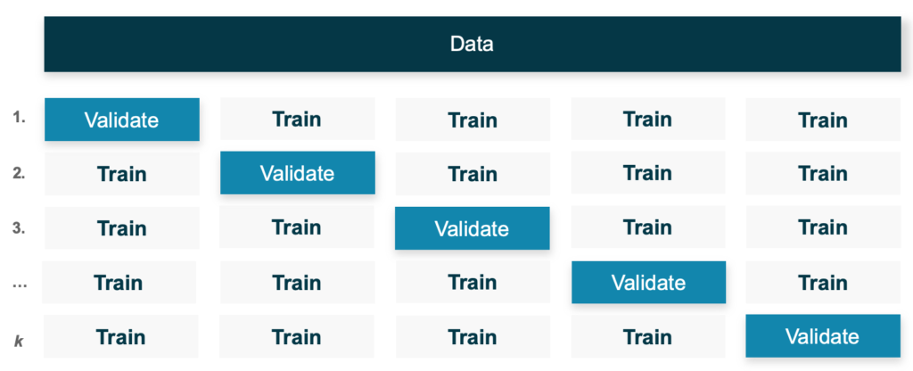
Implement a cross validation
Implement a cross validation approach to error estimation:
Add cross validation into code
Cross validation is simply using a testing set which is a small sample of the whole data and seeing how well it predicts new data
Cross validation- compare gravitational estimates to seismic point estimates
Do not have seismic estimates for whole continent
Figure 4- A diagram displaying how cross-validation works with a data set. Lukas Feick, 2019, Evaluating Model Performance by Building Cross-Validation from Scratch, viewed 5 January 2021, <https://www.r-bloggers.com/2019/10/evaluating-model-performance-by-building-cross-validation-from-scratch/>
Notes:
Cross validation in general is using a testing set to get a model and then inputting unseen data into this model and seeing how well the method predicts the output. Cross validation will help point out under/overfitting and any bias in the data.
Add figure about cross validation

Slide 9
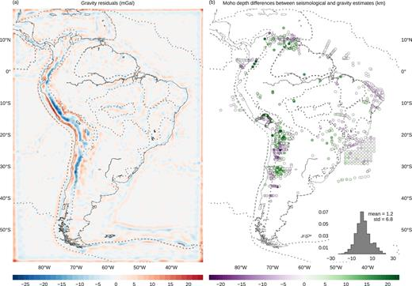
Modify the CRUST1.0 model
Modify the CRUST1.0 synthetic model to include unmodelled source/s:
Code from Uieda & Barbosa includes random noise in data
Didn’t include unmodelled sources
Modify code to include one or more unmodelled sources
Location of mass anomaly is difficult to pinpoint so will use trial and error
Figure 5- A model of the gravity residuals and differences between seismic and gravity estimates from Uieda & Barbosa(2017). Uieda, L. and Barbosa, V.C., 2017. Fast nonlinear gravity inversion in spherical coordinates with application to the South American Moho. Geophysical Journal International, 208(1), pp.162-176.
Notes:
-Non-uniqueness comes into effect here as multiple models with different mass anomalies can produce the same final result
-Shallow moho produces same result as positive density anomaly

Slide 10
Applying methodology
Apply methodology to real data:
Based off success of hold out cross-validation method can apply method to real data
For instance can use South American data that Uieda & Barbosa (2017) used
If cross-validation doesn’t work then will just have a Moho depth model.
Or can look deeper into modelling subducting slab
Notes:
-what to do if don’t get good results (add)

Slide 11
Model effect of a subducting slab
Extra (time dependant): model effect of a subducting slab
Uieda & Barbosa (2017) model does not account for subducting Nazca plate just estimates it
Use Slab2 model to model the effect of this subducting slab
Assume crust and lithosphere thickness as priori data and calculate effects with tesseroids
Finally calculate how much it contributes to uncertainty of Moho depth
Notes:
-tesseroids, large area cannot assume to be flat. Adds realistic Earth curvature to model
-add citation for slab2

Slide 12
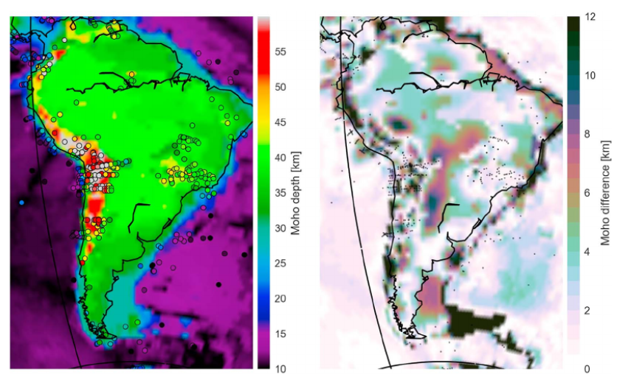
Where this project fits into current research
Many people have produced Moho models of South America
Few have included uncertainty estimates
Szwillus (2019) included uncertainty estimates in their model by using residual topography
Almost no papers have used approach of hold out cross-validation
Figure 6- Uncertainty estimates of South America based off residual topography and interpolation. Szwillus, W., Afonso, J.C., Ebbing, J. and Mooney, W.D., 2019. Global crustal thickness and velocity structure from geostatistical analysis of seismic data. Journal of Geophysical Research: Solid Earth, 124(2), pp.1626-1652.
Notes:
-re-read Szwillus paper

Slide 13
Possible future work
Adding a variable density contrast
In many papers a single density contrast is used for South America which isn’t geologically correct but does make coding easier
Can implement multiple density contrasts
May change how the unmodelled masses are estimated as well as reduce overall error
Notes:
-In many papers such as Van der Meijde (2013a) (model= GMSA12) a multiple density contrast is used and splits South America up into 14 geologically distinct
-Haas (2020) has also used this approach, seismic tomography to separate densities

Slide 14
Final Remarks
Modelling Moho depth through Inversion
Hardly any models include uncertainty estimates
Trying to estimate uncertainty from seismic point estimates
Trying to reduce effect of gravity residuals by adding unmodelled masses

Slide 15
References
Assumpção, M., Feng, M., Tassara, A. and Julià, J., 2013. Models of crustal thickness for South America from seismic refraction, receiver functions and surface wave tomography. Tectonophysics, 609, pp.82-96.
Laske, G. et al. (2013) CRUST1.0 A New Global Crustal Model at 1x1 Degrees [Online]. Available at: https://igppweb.ucsd.edu/~gabi/crust1.html (Accessed 18 November 2020)
Reguzzoni, M. and Sampietro, D., 2015. GEMMA: An Earth crustal model based on GOCE satellite data. International Journal of Applied Earth Observation and Geoinformation, 35, pp.31-43.
Szwillus, W., Afonso, J.C., Ebbing, J. and Mooney, W.D., 2019. Global crustal thickness and velocity structure from geostatistical analysis of seismic data. Journal of Geophysical Research: Solid Earth, 124(2), pp.1626-1652.
Uieda, L. and Barbosa, V.C., 2017. Fast nonlinear gravity inversion in spherical coordinates with application to the South American Moho. Geophysical Journal International, 208(1), pp.162-176.
Notes:
Just a list of references

Slide 16
What will be covered in this Overview
Introduction to the problem
Background work already completed
What still needs to be done
How the rest of the project will be completed
Where it fits into current research and future work based off this project

